Slide 1
William Beaven Portfolio Evidence

Slide 2
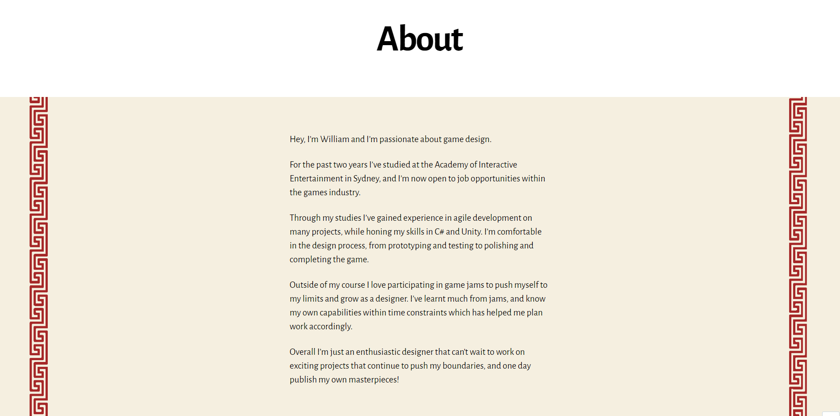

Slide 3
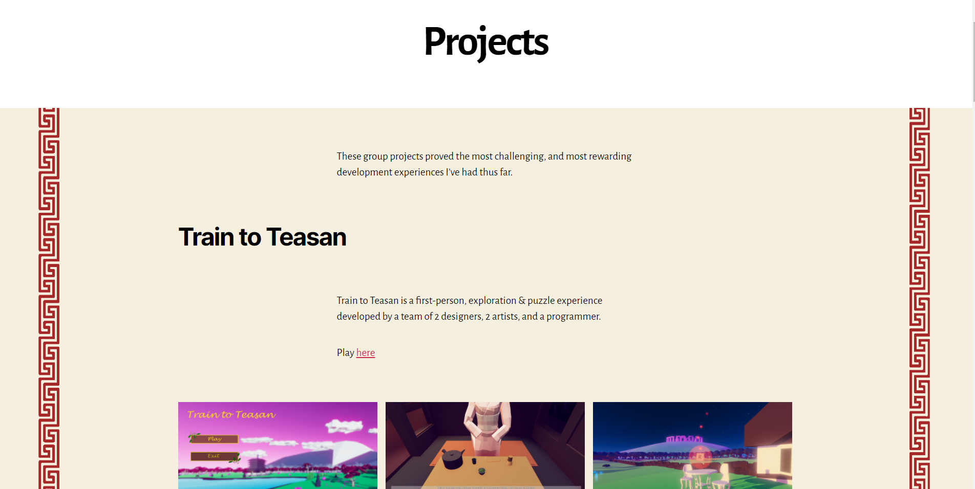

Slide 4
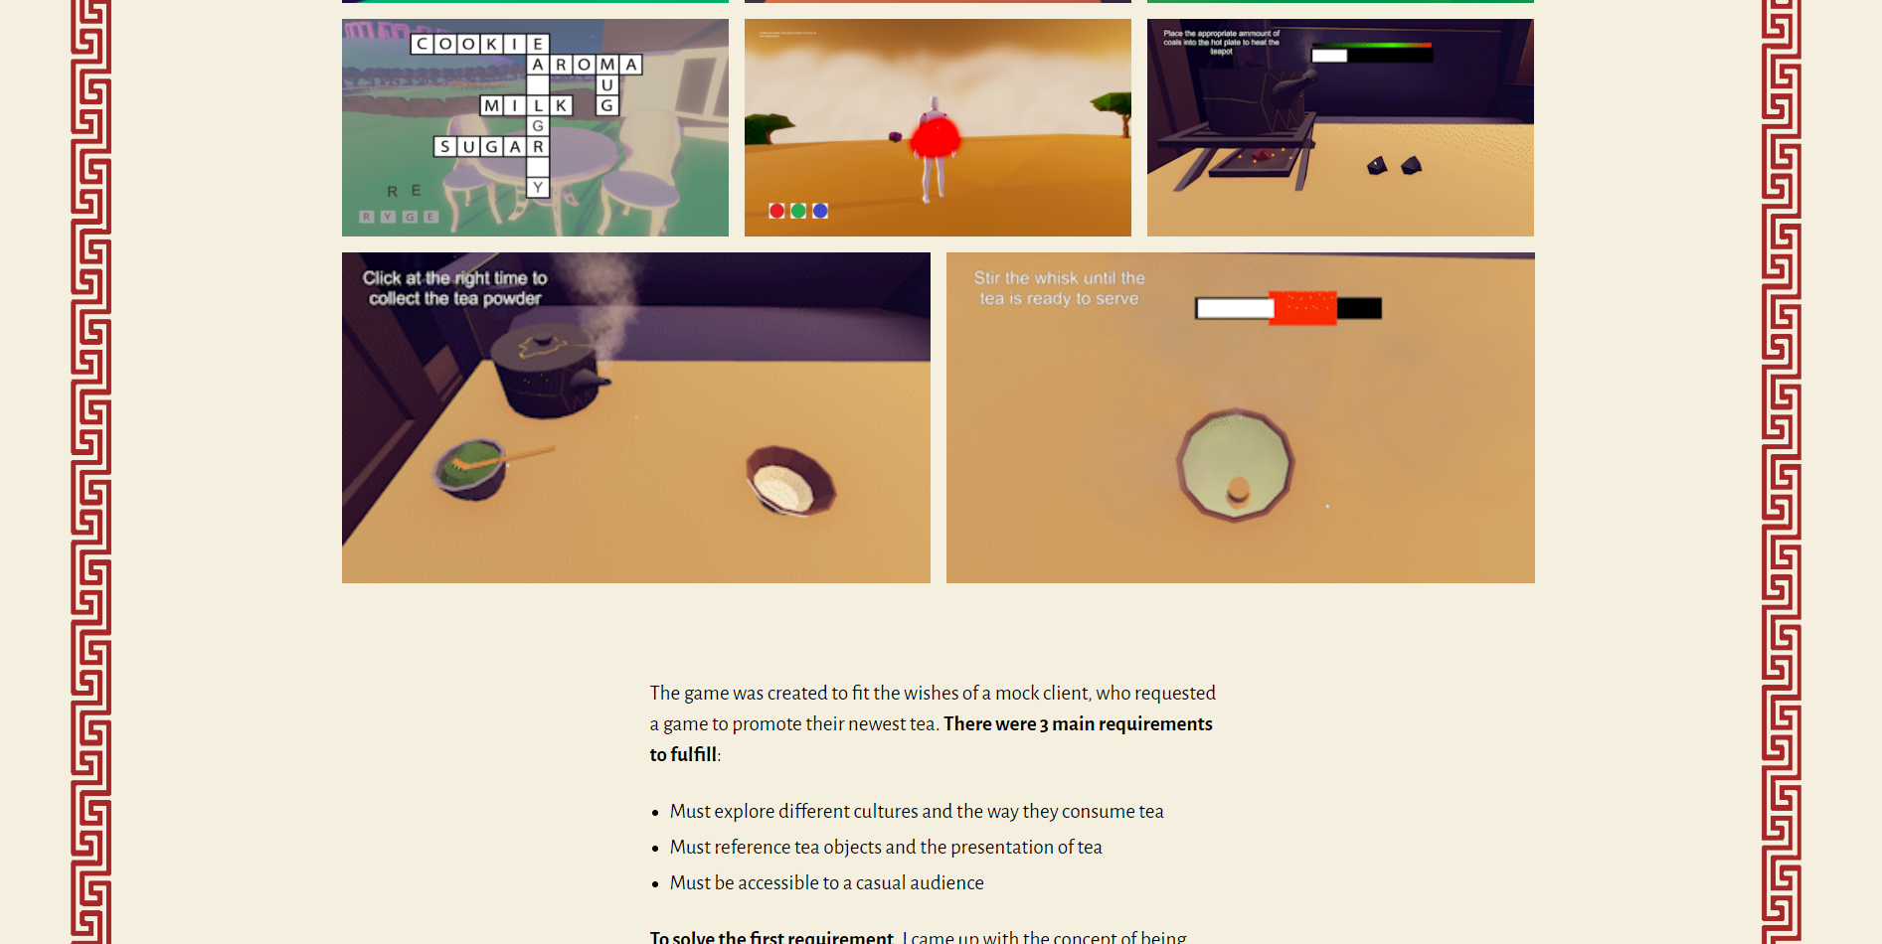

Slide 5
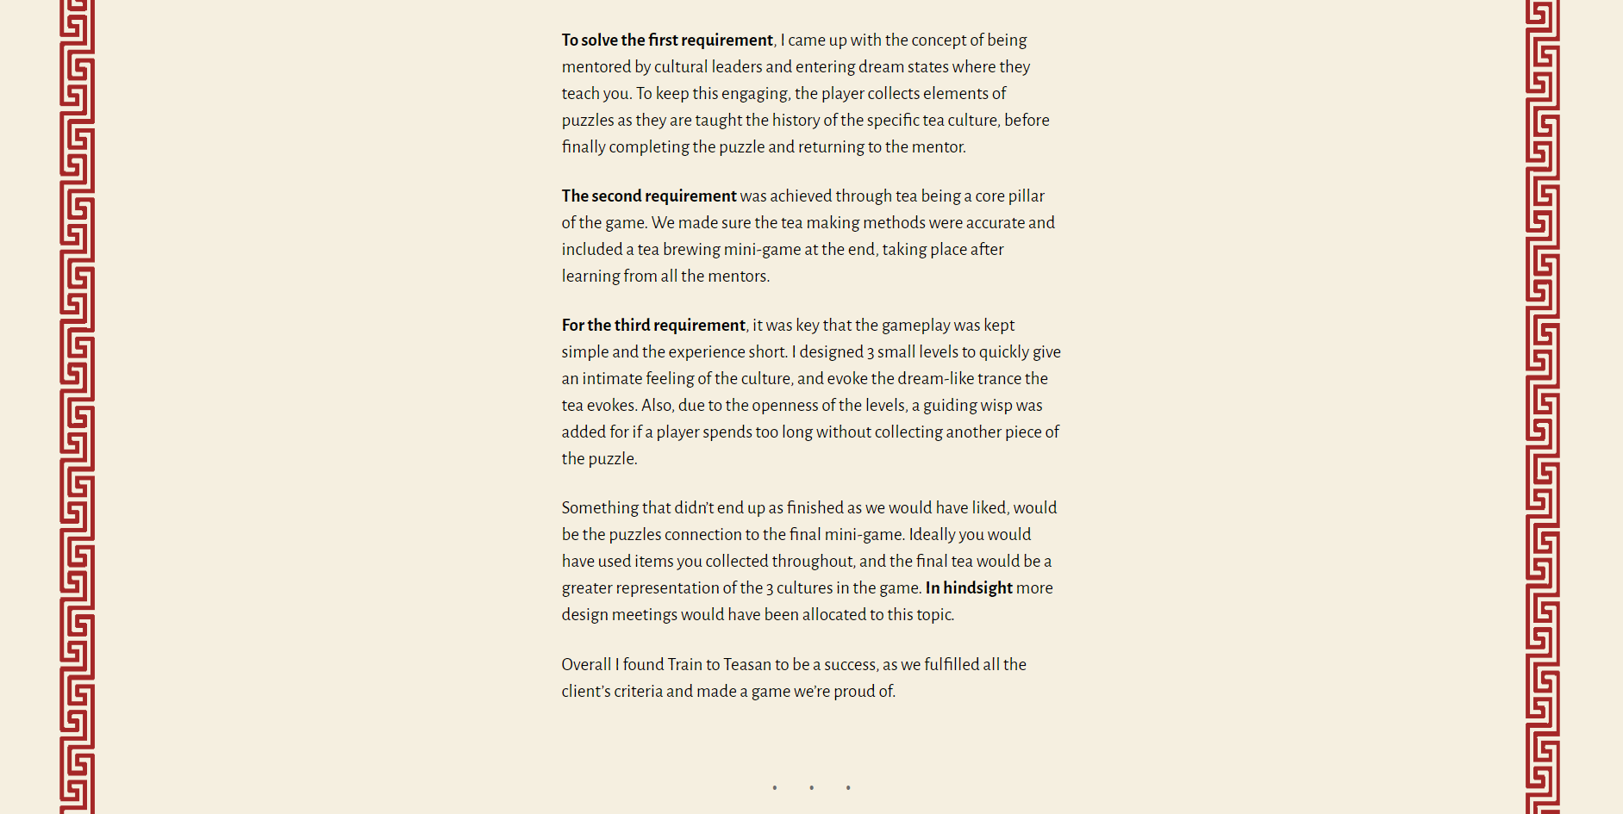

Slide 6
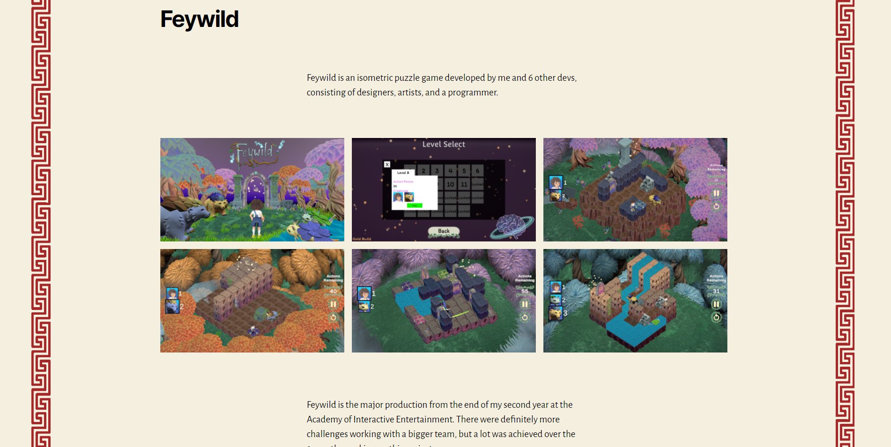

Slide 7
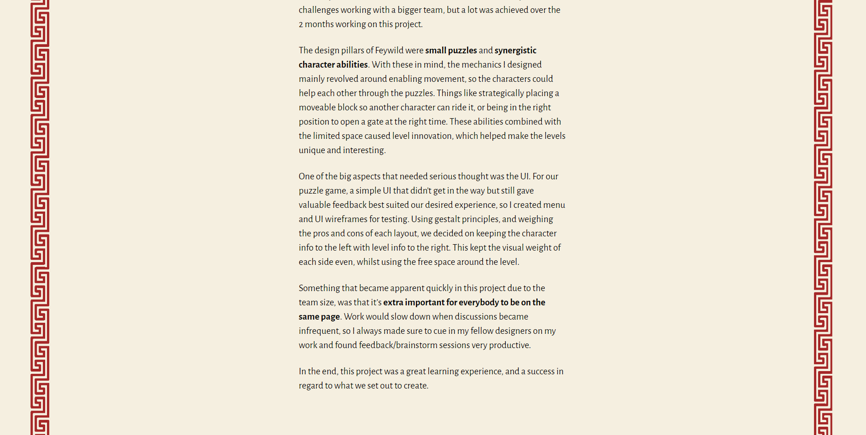

Slide 8
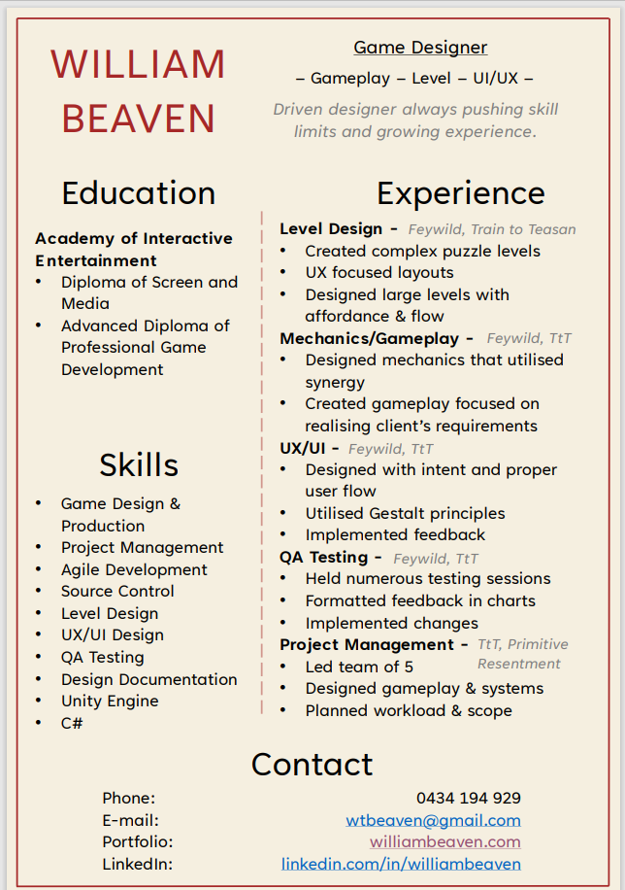

Slide 9
Portfolio Feedback
Supplier | Feedback
Sebastian | Overview my role in projects
O’Neil | Include what kind of designer I wanna be in intro & merge home/about pages
Sebastian | Instead of just saying what went wrong in a project, say how I now proceed
Myles | Include your process in another page with wireframes, GDDs, testing sheets, etc

